Slide 1
XRP Python
Programming the Drivetrain
Lesson 6
Loops

Slide 2
Learning Outcomes
Use the "for in range" command to repeat actions a specific number of times in your program.
Apply the "while" and "while not" commands to repeat actions based on whether a condition is true or false.

Slide 3
Loops
In programming, there are different ways of handling data and the ability of the robot to make decisions based on that data. There are different types of data that utilize different objects and the way that they are handled.

Slide 4
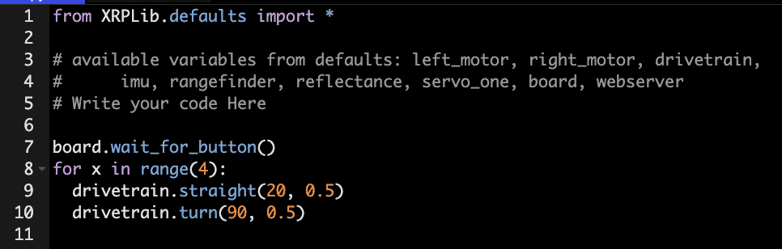
“For X In Range” Command
The “for x in range(4)” command will repeat the code that is inside it for the defined number of times.
Note: range(4) is not the values 0 to 4, but the values 0 to 3. The command defaults to a starting value of 0. And the increment is by 1.
This code will create a square. It will drive forward 20 cm, turn 90 degrees, and then repeat the code three more times.

Slide 5
Syntax
Remember that formatting and capitalization are important when programming in text-based code.
In the former example, remember the following:
The “for” must be all lowercase.
x can be any variable (x, y, a, b, c, count, etc.)
“in range” must be all lowercase.
(4) tells the programming how many times it would repeat the code.
“:” at the end is necessary. Just like when you programmed your “if” commands, this command also requires a “:” at the end. If this is done correctly, it will automatically tab the next line.
The code that is tabbed under your “for x in range” command will be performed for the desired times.

Slide 6




“For In Range” Command Examples
This code will start at 2 and go to 5 (not including 6).
This code will start at 2 and go to 30 and will do so in increments of 3.

Slide 7
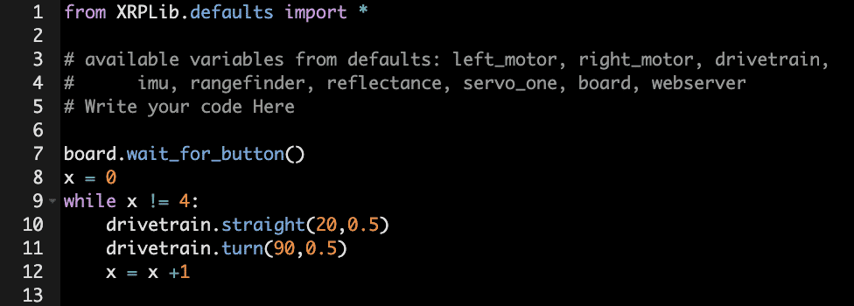
While and While Not Loop Commands
While Command
The while command will repeat the code that is inside it while the condition is true. This can be used to have a series of code repeat itself.
This set of code will also create a square. It sets the variable x equal to 0. Then, repeat while the variable x is not equal to 4. It will drive forward 20 cm, turn 90 degrees, then add 1 to the variable x, and then repeat until x equals 4. Try it out on your paper to see how it works. Don’t forget to use your marker to show your work.

Slide 8
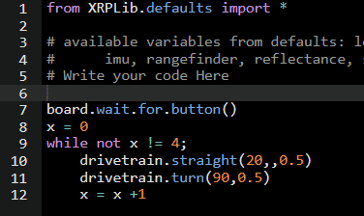
While and While Not Loop Commands
While Not Command
The while not command will repeat the code that is inside it until the condition is true (in this case, the user button is pressed).
This code will also create a square but will continue creating that square until you hit the user button.
Just like the repeat while, it will drive forward 20 cm and turn 90 degrees.
Try it out on your paper to see how it works.
Don’t forget to use your marker to show your work.
And remember to press the user button to start and press the user button again to stop the code.

Slide 9

Challenge 1
Create a triangle using the for i in range (n) command, where n is a number.
Make a 60-degree angle and make the length of each side 30 cm.
Don’t forget to add the “wait for user button” command at the top.

Slide 10
Challenge 2
Create a rectangle using the while command. You will need to use an if command and set a variable, x = 0, to start. If the number is even, you should drive 20 cm. If the number is odd, you should drive 30 cm.
Don’t forget to change x by 1.
Don’t forget to add the “wait for user button” command at the top.
Hint: If a number is even, it will be divisible by 2. An equation like (4 % 2) will return 0 because there is no remainder and is therefore even, while (5 % 2) will return 1 because there is a remainder and is therefore odd.

Slide 11
Challenge 3
Create a parallelogram using whatever loop command you want. Parallelograms have angles that are the same opposite of each other, and all 4 angles total 360 degrees.
The first angle will be 60 degrees.
The second will be 120 degrees.
Each side should be 30 cm long.
You will be using an “if-else” statement, for odd and even numbers, just like the previous challenge.
Don’t forget to add the “wait for user button” at the top.

Slide 12
Evaluate
Answer these questions to evaluate your understanding of the material covered:
Which command will repeat the code that is inside it, while the condition is true?
Repeat while
Repeat until
Count with
Repeat
Which command will repeat the code that is inside it, until the condition is true?
Repeat while
Repeat until
Count with
Repeat

Slide 13
Evaluate
Answer these questions to evaluate your understanding of the material covered:
Which command will repeat the code that is inside it, for the defined number of times?
Repeat while
Repeat until
Count with
Repeat
Which command will repeat the code that is inside it, until the variable reaches the top value?
Repeat while
Repeat until
Count with
Repeat

Slide 14
Reflect
Reflect on each of these questions:
What is the difference between a repeat while and repeat until loop?
How can you use math and variables in the count with command?
What factors other than programming will affect the robot’s ability to correctly draw a shape?

Slide 15
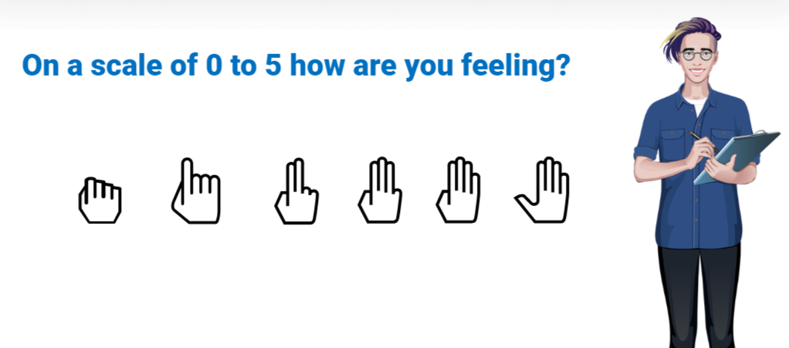
Assessment | Fist to Five
On a scale of 0 to 5, how are you feeling?

